Slide 1
Introduction to machine learning
Recap: Data Preparation and Feature Engineering
R. Brooks

Slide 2
Data Preparation
Data Exploration
Data cleaning
Feature selection
Feature Engineering and Data Transformation

Slide 3
Explore the data
Study each feature and its characteristics:
Name
Type (categorical, int/float, bounded/unbounded, text, structured, etc)
Percentage of missing values
Check for outliers, rounding errors, input errors etc.
Get descriptive statistics (e.g., number of samples, class imbalance, mean, variance, etc.)
For supervised learning tasks, identify the target(s)
Visualize the data
Study the correlations between features
Identify the promising transformations you may want to apply (e.g. convert skewed targets to normal via a log transformation)

Slide 4
Data Cleaning
Handle outliers and missing data
Keep, remove or replace outliers
Fill in missing values
Max/min or even 0
Mode, median, mean
Impute using regression

Slide 5
Feature Selection
Drop the features that provide no useful information for the task
Correlation analysis
Feature selection model
Domain knowledge
Quality of data (drop columns)
Factor Analysis (not technically curriculum)

Slide 6
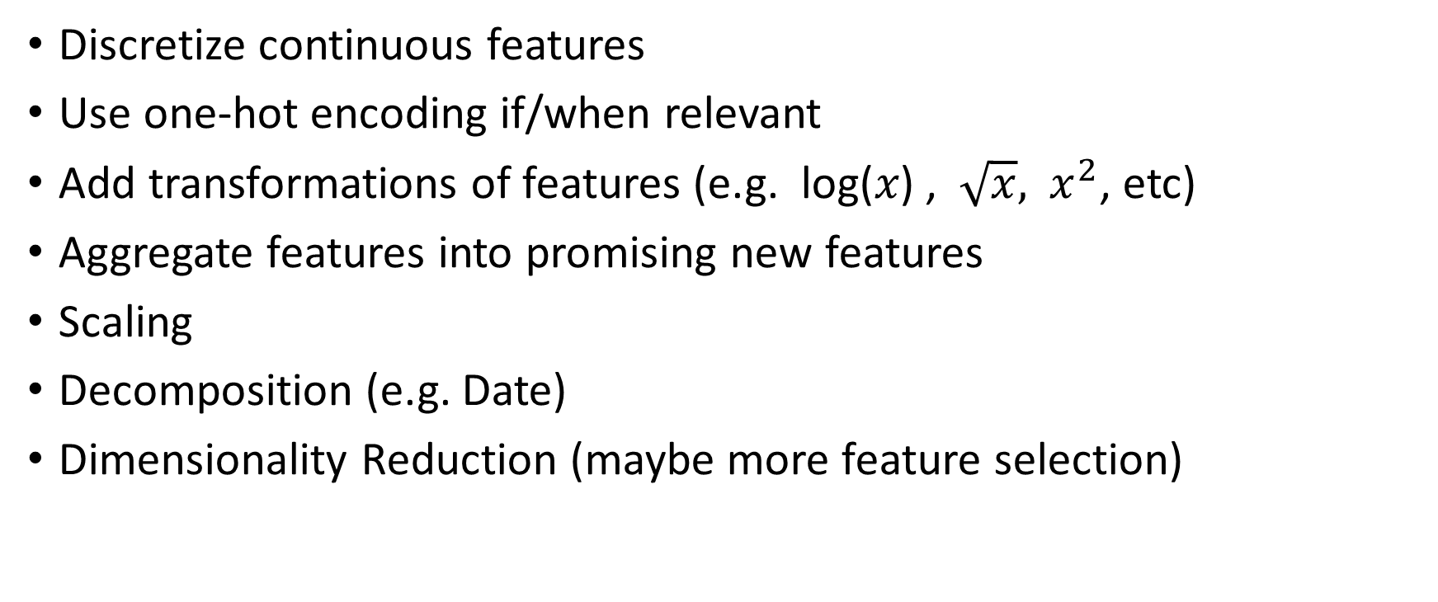
Feature Engineering and Data Transformation
Discretize continuous features
Use one-hot encoding if/when relevant
Add transformations of features (e.g. log(𝑥) , $\sqrt{x}, { x}^{2}$, etc)
Aggregate features into promising new features
Scaling
Decomposition (e.g. Date)
Dimensionality Reduction (maybe more feature selection)

Slide 7
Data Preparation
But when should you do this?

Slide 8
Tune hyperparameters
Validation accuracy
Data
Machine learning algorithm
Training data
Trained
model
Features
Labels
Labels
Validation data
Testing data
Ideally you should isolate you testing data before you do anything else! That means only doing data cleaning and feature engineering on training and validation data.
Test accuracy

Slide 9
But sometimes that is quite impractical. So for simplicity, we will in some cases do data preparation on all data, and separate the testing data after that!
Tune hyperparameters
Validation accuracy
Data
Machine learning algorithm
Training data
Trained
model
Features
Labels
Labels
Validation data
Testing data
Test accuracy

